Slide 1
Abstraction Planning and Diagnostics for Human-Robot Collaboration
Oliver Michael Kamperis
School of Computer Science
University of Birmingham
Primary Supervisor: Marco Castellani
Secondary Supervisor: Yongjing Wang
Nominal Supervisor: Dave Parker

Slide 2
Human-Robot Collaboration
The act of humans and robots operating in close proximity.
Humans may be:
Cooperative: Provide physical effort towards the goal,
Commanding: Assign goals to the agents,
Exogenous: Their actions may change the state.
Proposed evaluative HRC application domains:
Service Robots,
Collaborative Disassembly (HRCD),
Collaborative Construction (HRCC).
Notes:
I refer to human-robot collaboration as the general act of humans and robots operating in close proximity to one another.
It is effectively any situation where a robot is operating in a space where a human may be present and the robot must therefore be able to deal with and reason about the unpredictable actions and behaviour of humans.
And I categorise these humans into three different groups:
Cooperating humans are those that form part of the team operating towards the achievement of some goal or the completion of some task. They are planning agents just like the robots so we can plan actions that should or must be completed by cooperating humans rather than the robots.
Commanding humans are those that simply assign goals the available planning agents. These are still effectively part of the agent team but they are not available to provide physical effort towards achieving the goal.
And there are exogenous acting humans. These are humans that exist in the domain and but usually do not fall into either of the other two categories, but the primary issue is that humans will come along and do stuff in the domain, changing the state unbeknownst to the robot and the planning system, and this often leads to the robots encountering or observing something that contradictions their expectations which will often invalidate their plan and require them to diagnose and re-plan. So exogenous acting humans are one of the major properties of HRC domains that contribute towards the requirement to support integrated planning and diagnostics, the other being incomplete domain state knowledge.
Of course there are some overlap between these, so a cooperating human might do something that was not accounted for in the plan, humans are unreliable so we cannot always predict accurately what they will do or what the extent of the efforts will be.
The main HRC domains that I want to consider in this thesis are:
Service robotics operating in domains such as office spaces, which was used in the examples I presented in the report, and hospitality or healthcare domains,
Human-robot collaborative disassembly, which I will talk more about in the next slide,
And finally, human-robot collaborative construction, which is quite ambitious but could be very interesting as a possible extension if there is sufficient time as it is the seminal field of HRC.

Slide 3
HRCD
Disassembly sequence planning deals with planning the sequence in which components of End-Of-Life products must be removed for reuse or recycling.
However, diversity of products and uncertainty in the quality of their components makes it difficult.
HRCD deals with the semi-autonomous disassembly.
Semi-autonomous of disassembly is a middle ground in terms of cost and efficiency making it economically and environmentally beneficial.
Notes:
HRCD is a field of re-manufacturing dealing with the disassembly of end-of-life products returned for reuse, repair or recycling.
DSP is the first step in re-manufacturing and deals with computing the sequence in which the components of such products should be removed.
Unfortunately, complete autonomy
A problem to which non-monotonic logical KRR paradigms such as Answer Set Programming have not before been applied.

Slide 4
Thesis Contributions
Aim to produce domain-independent ASP based centralised reasoning system for HRC which inherently supports the ability to reason over an arbitrary number of abstractions.
Support hierarchical abstraction planning and diagnostics,
Provide a domain-independent approach to centralised planning with teams of multiple heterogenous agents,
Support partial planning and oversubscription planning,
Enable plan-repair when plans are partially invalidated.
Notes:
The aim is to produce a domain-independent Answer Set Programming based reasoning system that is able perform centralised reasoning for teams of multiple heterogenous agents, including various different types of robot and human collaborators, which inherently supports the ability to reason over any arbitrary number of desired abstractions of a state space an ability which has not before been demonstrated in ASP.
The central idea is that the reasoning system generates a unique plan at each desired level of abstraction.
The effects of actions planned at the previous abstraction level are then passed as sub-goals to the next level which the planner must satisfy in the correct order, thus ensuring plan conformance between abstractions.
In this way the planner generates a hierarchical plan over multiple abstractions the nature of which I will again discuss in a moment.
So I will just briefly list the four main points of novelty in the implementation of the reasoning system:
Provide support for planning and diagnostics over a hierarchy of abstraction spaces,
Provide a domain-independent approach to centralised planning for teams of multiple heterogenous planning agents including robots and humans,
Provide support for partial planning by inferring sub-problems for plans generated at the previous abstraction, again I’ll explain that a bit more later, and support oversubscription planning, which is a type of planning in which the objective is to satisfy the highest utility sub-set of goals rather than all goals, both of these have not bee demonstrated in ASP before because an ASP program must always compute a full model, but will the use of abstraction we can effectively side-step that restriction,
And lastly, enable plan repair when plans are invalidated by observations that contradict expectations, what these means is that we can identify parts of the hierarchical plan that are made invalid by an unexpected observations and repair just that part to save us from having to re-generate the entire plan.
These capabilities have not been implemented into an Answer Set based reasoning system before.
Novelty partially from the new capabilities that I enable the proposed ASP based reasoning system with and partially from application of ASP itself to planning problems to which it has not before been applied (ASP is quite new).

Slide 5
Abstraction in Planning
Abstraction is integral to reasoning and problem solving.
Low-relevancy details can be simplified away to reduce complexity or assumptions made to cope with unknowns.
The advantages of abstraction in planning are:
Planning in an abstract space is exponentially faster,
Abstract plans are much less likely to fail,
Abstract plans can be used to infer sub-problems in the ground space allowing the computation of partial-plans.
Notes:
Abstraction is integral to human problem solving and has been observed in almost all areas of science, engineering and everyday life.
Humans often employ abstraction when solving complex problems such a planning actions towards some specific goal, or providing explanations to another human.
The primary motivator is that by solving a problem in an abstract space we can find a solution exponentially faster than in the original ground space, and we can then use that solution to ease our search for a solution in the ground space.
Indeed we find that in the real world it is almost always better to plan in an abstract space initially than attempting to generate a complete plan in the ground space because there are usually so many unknowns that a ground level plan will be bound to fail at some point during plan execution.
So not only does abstraction make it easy and faster to find solutions by reducing problem complexity, it also makes the plan less likely to fail, if assumptions that were made to construct that abstraction hold, and I’ll give a brief example of this later on.
Abstraction also allows us to automatically split the ground level planning problem into sub-problems inferred from the abstract plan.
This means that we can generate a partial plan into a small horizon into the future, which is of course usually much faster than computing a complete plan, and this also means that if the plan fails we have wasted less time, also, because we are planning into a shorter future horizon, we generally much less unknowns to deal with.

Slide 6
Planning Domain Descriptions
Engineer first designs a planning domain description that is sufficiently expressive to deal with the application.
Abstractions are then created through simplifications.
Abstraction rules map state representation over abstractions.
Simplifications include:
Reductions: Remove constraints which forbid actions,
Refinements: Remove detailed features of entities,
Redefinitions: Replace the original domain description with a high-level description of the given task.
Notes:
The use of abstraction in autonomous planning is not a new concept.

Slide 7
Planning Domain Descriptions
A collection of logic rules at each desired level of abstraction defining the dynamic behaviour of the domain at that level.
Action Effects
R : move(P) causes location(R) = P
Action Enabling Conditions (Preconditions)
impossible R : grasp(O) if location(R) != location(O)
State Constraints
location(O) = location(R) if grasping(R) = O
Notes:
Planning always requires some formal description of a planning domain.
In our case this needs to be done over different abstractions.
At each abstraction there is a collection of logic rules defining the dynamic behaviour of the domain at that level.
In ASP these definitions are highly intuitive and elaboration tolerance.
Type of rules include those describing:
The effects of the agents’ available actions – When a robot R moves to a place P its location changes to P,
The enabling conditions of those actions, also called preconditions – A robot R cannot grasp an object O if the robot does not share the location of the object,
And constraints on the domain state – Grasped object share the location of the robot that is grasping them.
This is not an exhaustive list of different types of logic rule, but the general concept is you represent the planning problem as a series of logic rules of this form that define and restrict the dynamic behaviour of a planning domain and the planning agents operating within it.

Slide 8
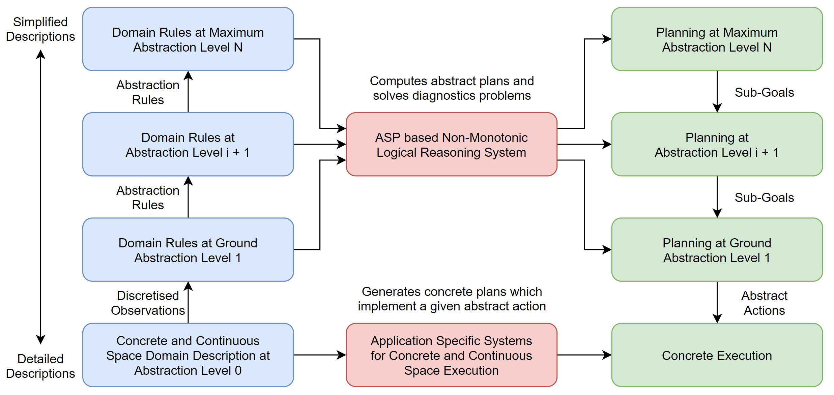
Planning Domain Descriptions

Slide 9
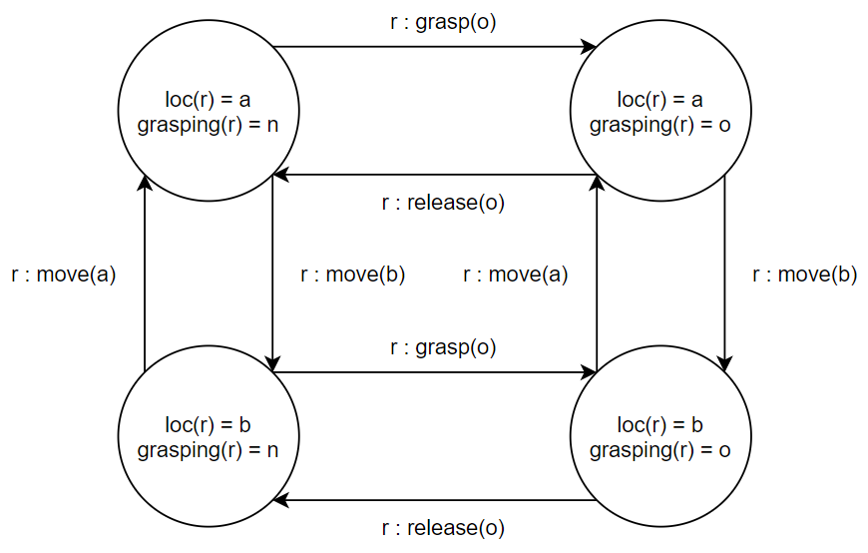
State Transition Diagrams
Directed graph whose nodes are unique domain state and whose arcs are set of actions that transition between states.
Planning requires finding a trajectory through that graph.

Slide 10
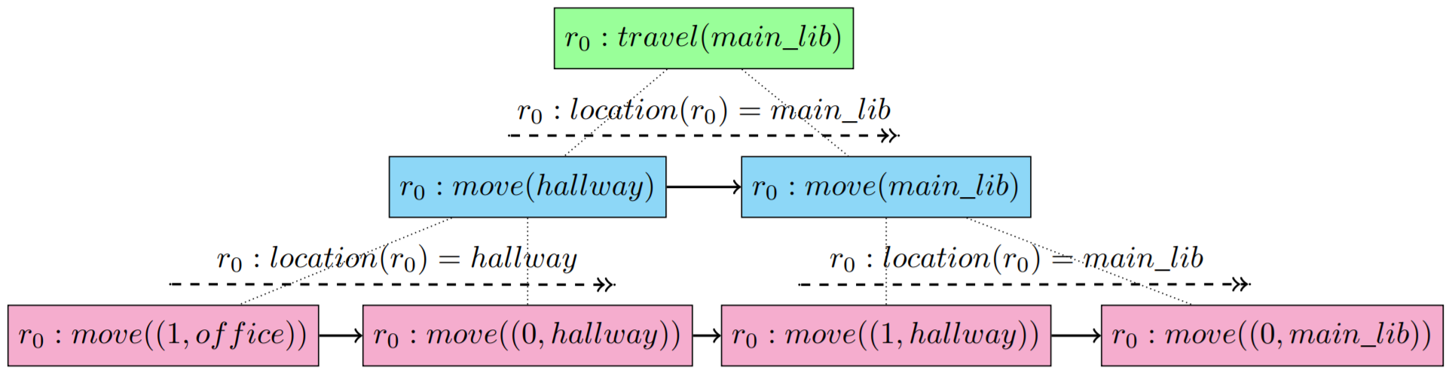
Generated Plans
A unique trajectory is generated at each level of abstraction.
The effects of actions planned at the higher levels are passed as sub-goals to the lower levels to ensure plan conformance.
A plan is an ordered sequence of decomposition trees.

Slide 11
Decomposition Trees
At the head is a non-empty set of actions,
Possibly empty set of child nodes which are themselves each another discrete decomposition tree,
Non-empty set of sub-goals achieved by its children.

